Slide 1

Year 9 Chemistry Review
Notes:
Insert cover image and use transparency settings to fade image.

Slide 2


Year 9 Review
I can / will be able to:
Draw a labelled diagram of an atom
Describe the properties of subatomic particles (P, N, E)
Recall how to read an element from the Periodic Table
Explain the difference between an isotope and an element
List and briefly explain the key discoveries in Atomic History
Draw electron configurations of the first 20 elements

Slide 3
READ WITH ME
Draw a labelled diagram of an atom of lithium

Slide 4
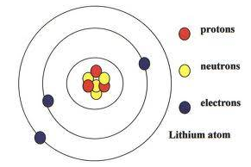
READ WITH ME
Draw a labelled diagram of an atom of lithium

Slide 5
Subatomic particles
Particle | Symbol | Location | Relative charge | Relative mass
proton
neutron
electron

Slide 6
Subatomic particles
Particle | Symbol | Location | Relative charge | Relative mass
proton
neutron
electron

Slide 7
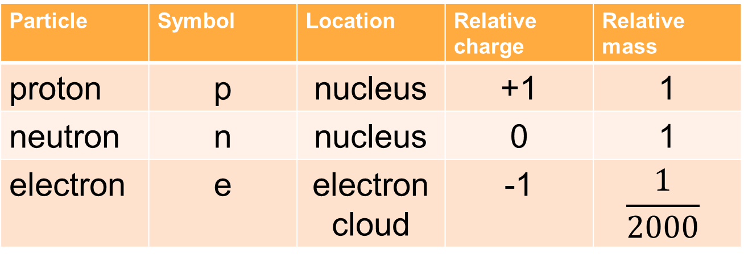
Subatomic particles
Particle | Symbol | Location | Relative charge | Relative mass
proton | p | nucleus | +1 | 1
neutron | n | nucleus | 0 | 1
electron | e | electron cloud | -1 | $$\frac{1}{2000}$$

Slide 8
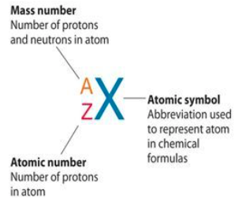
Representing elements
An element can be represented using a symbol

Slide 9
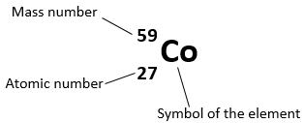
Example
Element name =
Number of protons =
Number of neutrons =
Number of electrons =

Slide 10
Answers
Element name = cobalt
Number of protons = 27
Number of neutrons = 32
Number of electrons = 27

Slide 11
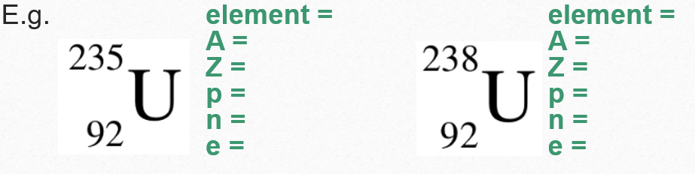
Isotopes
Isotopes are atoms with the same number of protons but different numbers of neutrons. This means that they are the same element but have different masses.

Slide 12
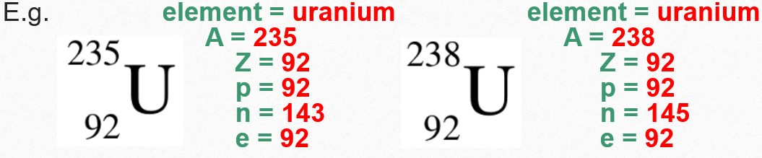
Answers
Isotopes are atoms with the same number of protons but different numbers of neutrons. This means that they are the same element but have different masses.

Slide 13
ATOMIC STRUCTURE

Slide 14
ATOM: smallest piece of an element.
Atoms are TOO SMALL TO SEE with our eyes.
We must USE EVIDENCE from experiments to CREATE MODELS of what atoms might look like.

Slide 15
MODEL: a representation of an object or event.
Models of the atom started being made approximately 2500 YEARS AGO.
These models have been modified due to better observations.

Slide 16
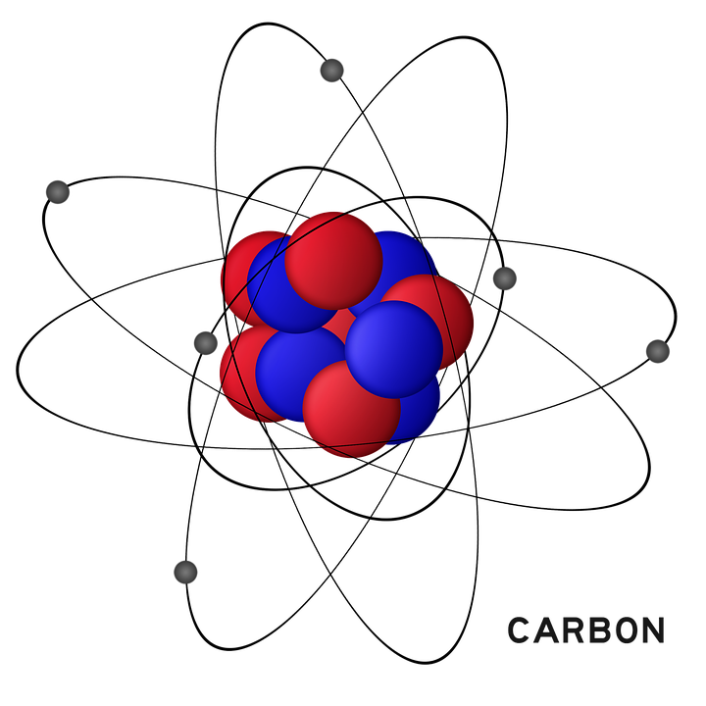
https://www.thepostemail.com/2018/03/22/deceptive-language-ruins-earth-hour/carbon-atoms/

Slide 17
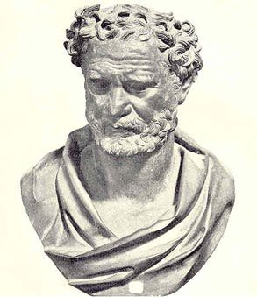
DEMOCRITUS’ MODEL (400BC): all matter is made of TINY PIECES (atomos) that CANNOT BE DIVIDED.
Liquid atoms were round and smooth.
Solid atoms were rough and prickly.
https://medium.com/@arnaldogunzi/about-atoms-and-the-void-935eb9de9028

Slide 18
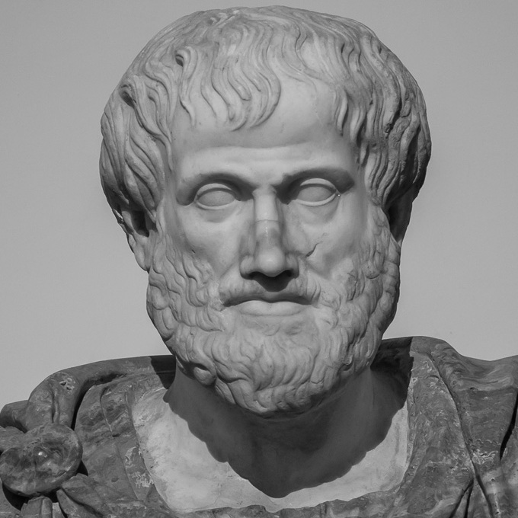



ARISTOTLE’S MODEL (300BC): all matter is made of FOUR ELEMENTS.
FIRE
HOT
DRY
AIR
EARTH
WET
COLD
WATER
https://www.optimize.me/authors/aristotle

Slide 19
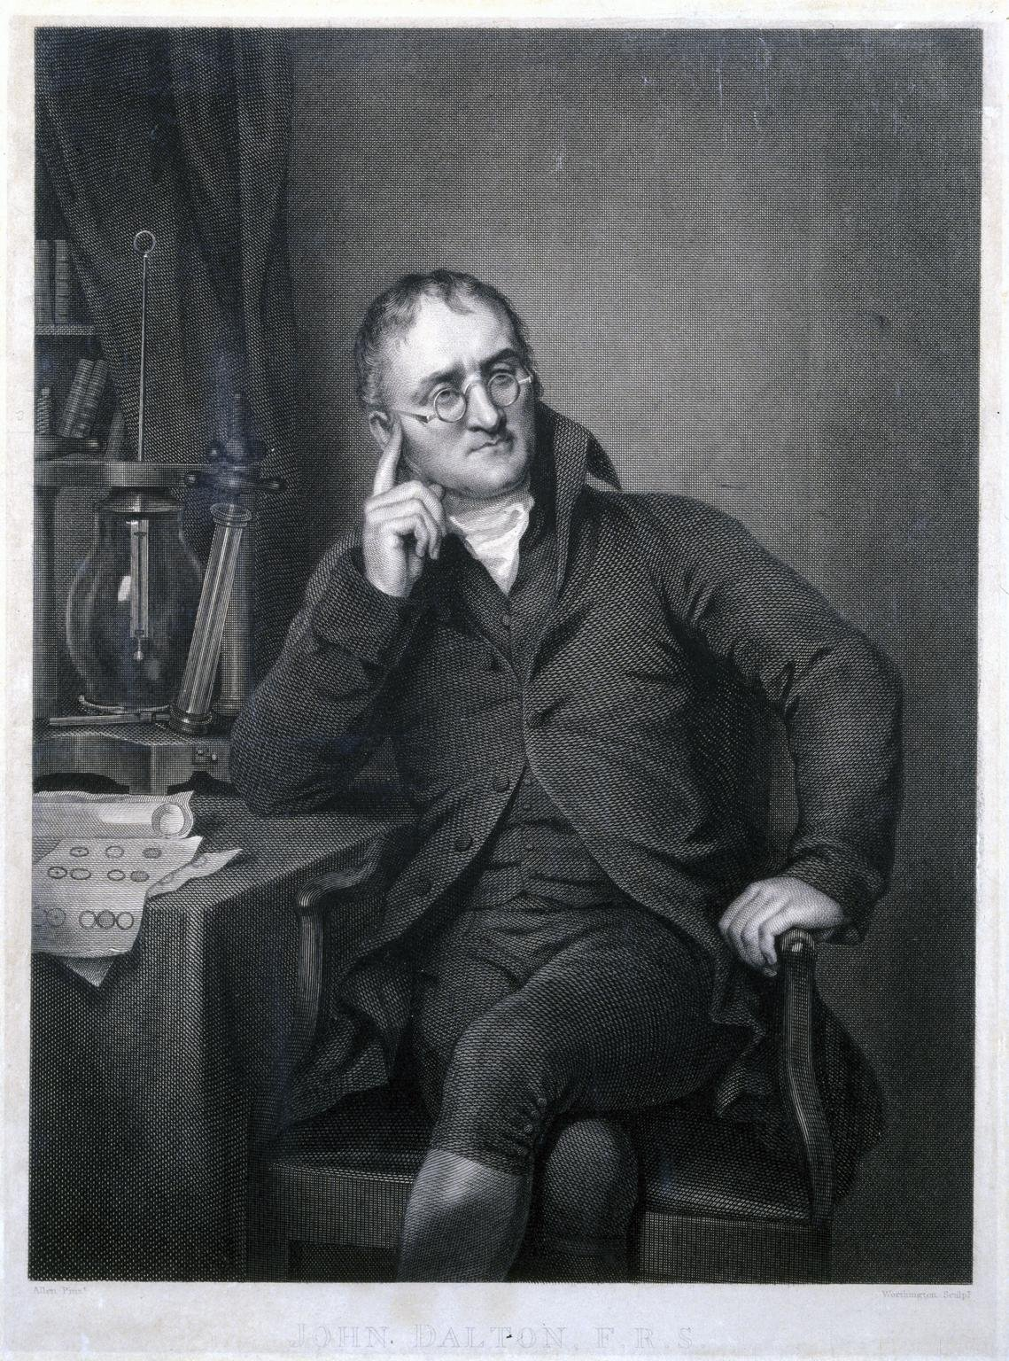
DALTON’S MODEL (1800): all matter is made of individual particles called ATOMS, which CANNOT BE DIVIDED into smaller pieces.
https://www.scienceandindustrymuseum.org.uk/objects-and-stories/john-dalton-atoms-eyesight-and-auroras#&gid=1&pid=1

Slide 20
DALTON’S THEORY:
All elements are made of atoms.
All atoms of the same element have the same mass (atoms of different elements have different masses).
Compounds contain atoms of more than one element that always combine the same way.

Slide 21
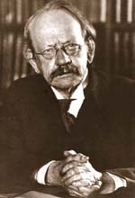
THOMSON’S MODEL (1900): atoms are made of smaller pieces, called SUBATOMIC PARTICLES.
https://history.aip.org/history/exhibits/electron/jjsound.htm

Slide 22

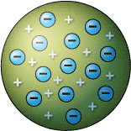
THOMSON’S PLUM PUDDING MODEL
https://www.friendlys.com/ice-cream-item/chocolate-chip/
CHOCOLATE CHIP ICE CREAM
The ice cream is a mass of positively charged matter.
The chips are negative particles spread throughout the matter (ice cream).
https://www.slideshare.net/yoruneko/jj-thomson-the-plum-pudding-model-presentation

Slide 23
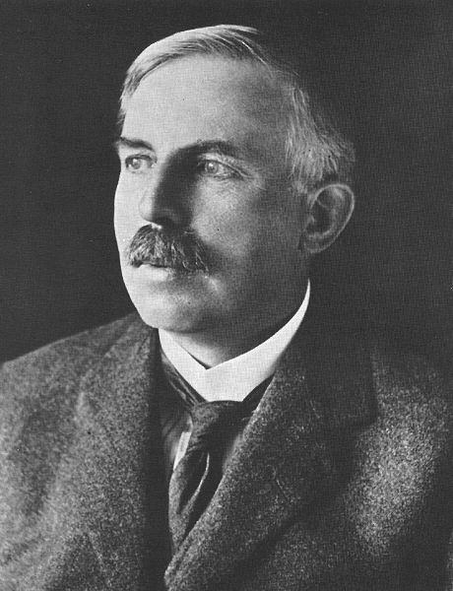
RUTHERFORD’S MODEL (1911): all of an ATOM’S POSITIVE CHARGE is concentrated in the NUCLEUS.
Nucleus: dense, positively charged mass located in the center of the atom (nuclei).
https://en.wikipedia.org/wiki/Ernest_Rutherford

Slide 24
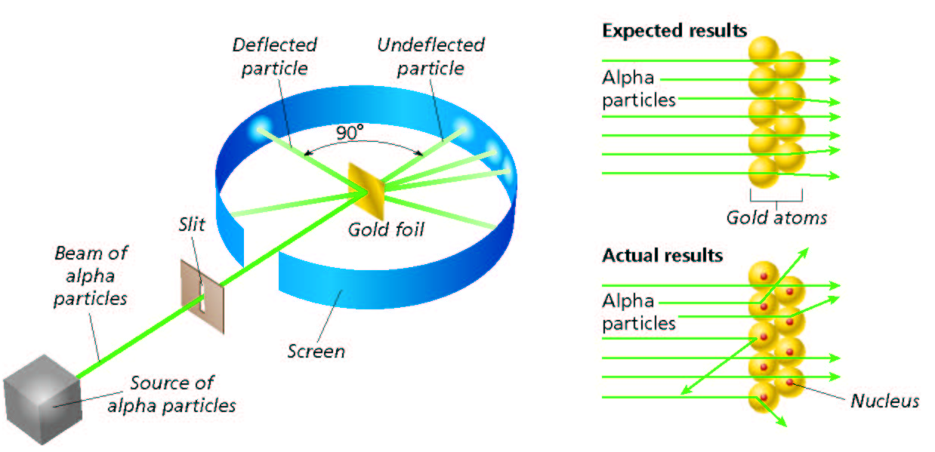
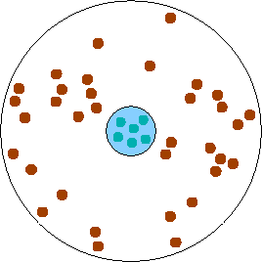
RUTHERFORDS GOLD FOIL EXPERIMENT
electron
nucleus
http://hobbsschools.net/textbooks/9%20physical%20science/iText/products/0-13-115206-8/ch4/ch4_s1_4.html
http://astronomy.nmsu.edu/geas/lectures/lecture18/slide01.html

Slide 25
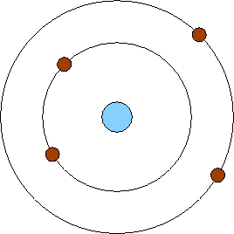
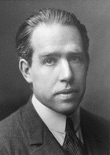
BOHR’S MODEL (1913): electrons move at CONSTANT SPEEDS in CIRCLES (fixed orbits) around the nucleus, called ENERGY LEVELS.
possible electron orbits
nucleus
http://astronomy.nmsu.edu/geas/lectures/lecture18/slide01.html
https://en.wikipedia.org/wiki/Niels_Bohr

Slide 26
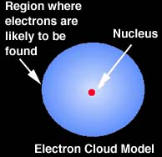
ELECTRON CLOUD MODEL (1926-MODERN THEORY): describes the POSSIBLE LOCATIONS of electrons around the nucleus.
https://slideplayer.com/slide/8759382

Slide 27
ELECTRON ARRANGEMENT

Slide 28
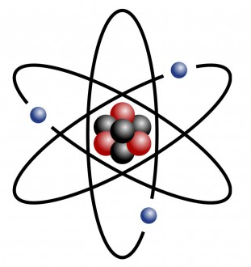
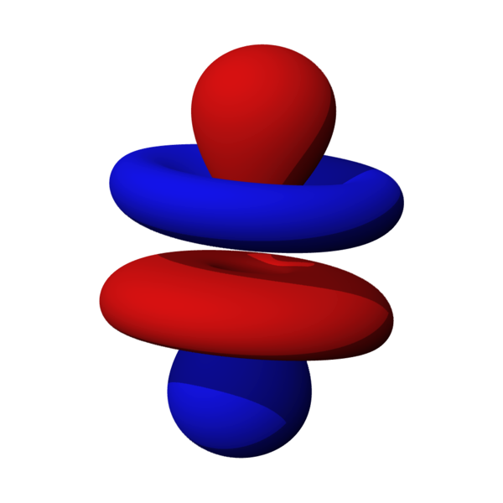
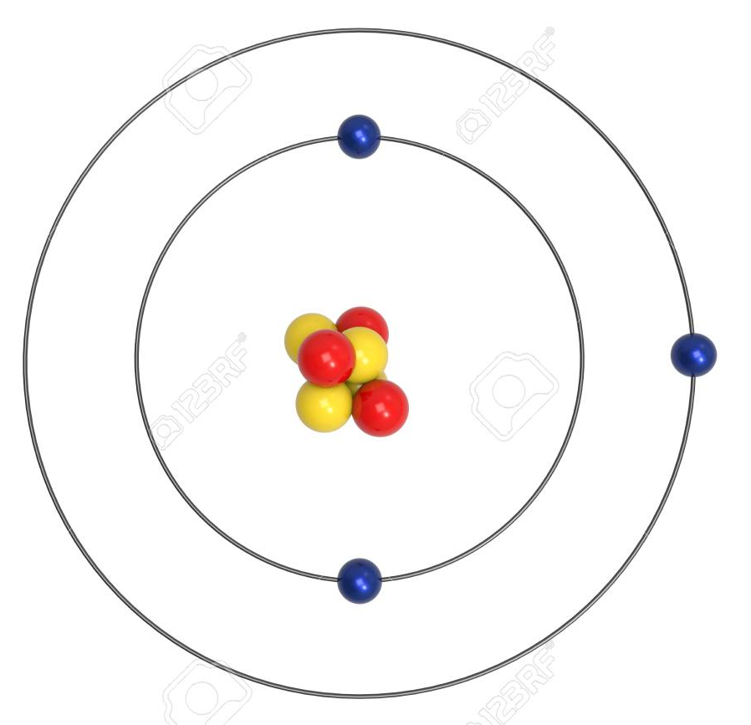
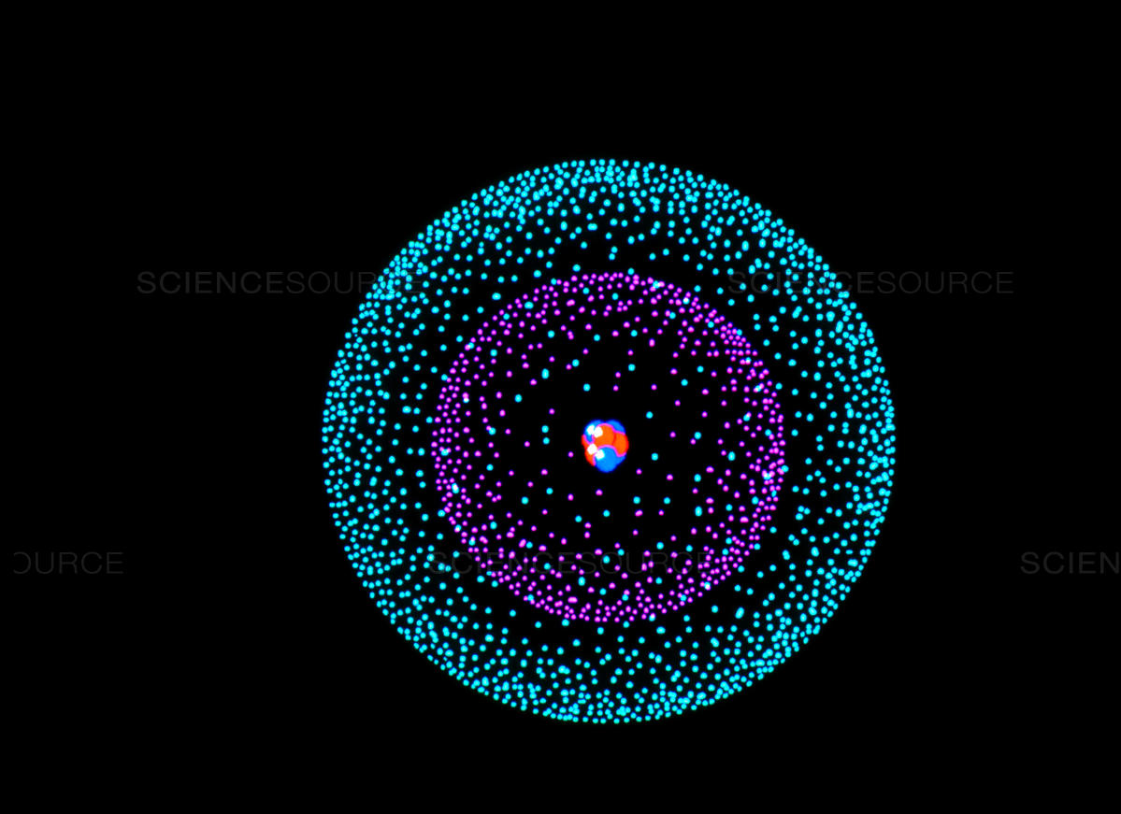

Slide 29
READ WITH ME
Electron arrangement
The arrangement of electrons in an atom is important because it determines the chemical properties.
Electrons are arranged in electron shells (energy levels). The lowest shells are filled first, with electrons with the least energy. Higher shells contain electrons with more energy.

Slide 30
READ WITH ME
Electron arrangement
Electron shell | Maximum number of electrons
1 | 2
2 | 8
3
4
5
Can you work out the rule for the maximum number of electrons allowed in each electron shell?

Slide 31
READ WITH ME
Electron arrangement
Can you work out the rule for the maximum number of electrons allowed in each electron shell?
2n²
Electron shell | Maximum number of electrons
1 | 2
2 | 8
3 | 18
4 | 32
5 | 50

Slide 32
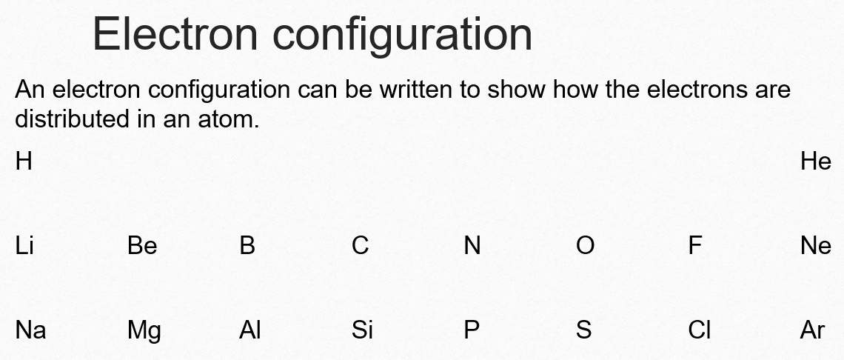

Slide 33
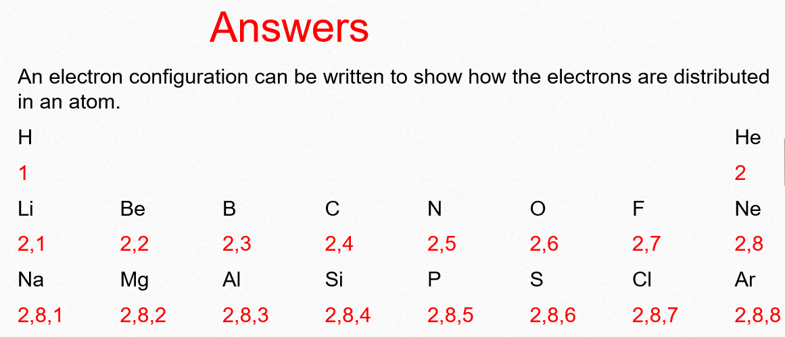

Slide 34
Year 9 Review
I can / will be able to:
Draw a labelled diagram of an atom
Describe the properties of subatomic particles (P, N, E)
Recall how to read an element from the Periodic Table
Explain the difference between an isotope and an element
List and briefly explain the key discoveries in Atomic History
Draw electron configurations of the first 20 elements

